Slide 1


Department of Information Technology
Velagapudi Ramakrishna Siddhartha Engineering College
REPORT GENERATION ON CHEST X-RAYS USING DEEP LEARNING
COMPUTER VISION AND REMOTE SENSING
B.Tech in Information Technology
Epics Project Review Presentation
Presented by
Jaya Naga Venkata Sai Motamarri (208W1A12A0)
Monica Panitini (208W1A12A5)
Saiesh Vemulapalli (208W1A12C7)
Under the guidance of
Dr. M.Ashok kumar , Assistant professor

Slide 2
PROBLEM STATEMENT
The chest x-ray is the most commonly performed diagnostic x-ray examination. A chest x-ray produces images of the heart, lungs, airways, blood vessels, and the bones of the spine and chest. Often time, it is the duty of a radiologist to conclude these x-rays so that to give appropriate treatment to the patients. It is often time-consuming and tedious to get detailed medical reports from these x-rays. In high population countries, a radiologist may come across 100s of x-ray images. So if a properly learned machine learning model can automatically generate these medical reports, considerable work and time can be saved.

Slide 3
Objectives & Outcomes
Objectives:
This project aims to present a compilation of the most outstanding deep learning strategies focused on the automatic generation of medical reports from X-Ray images.
In order to handle this challenging problem, deep learning algorithms have been include with models, to get promising results.
Outcome:
The medical report generated from the model in the final stage.

Slide 4
LITERATURE REVIEW
S.NO | TITLE | PUBLICATION YEAR | SUMMARY | Results
1 | Attention based automated radiology report generation using CNN and LSTM | 2022 | In this paper, to address this issue an approach is proposed,based on the continuous integration of convolutional neural networks and long short-term memory for detecting diseases, followed by the attention mechanism for sequence generation based on these diseases | Various images were tested using three methods, that is, VGG + LSTM, VGG + GRU, and VGG + Bi-directional LSTM. The training process is accomplished for the above-mentioned models, and the results are obtained and clearly identified that the VGG + LSTM model is more accurate than the other techniques
2 | Report Generation of Lungs Diseases from Chest X-ray using NLP | 2022 | In their experiments, they described a strategy on the basis of CNN-RNN architecture with attention mechanism. Predicted the results of their model trained on the dataset. | In this the CNN-RNN with attention model is more accurate than the encoder and decoder model.
3

Slide 5
S.NO | TITLE | PUBLICATION YEAR&PAPER TYPE | SUMMARY | Results
3 | An Automated medical report generation | 2020 | In this paper, they build a multi-task learning framework which jointly performs the prediction of tags and the generation of paragraphs, propose a co-attention mechanism to localize regions containing abnormalities and generate narrations for them, develop a hierarchical LSTM model to generate long paragraphs | the models with a single LSTM decoder perform much worse than those with a hierarchical LSTM decoder
4 | Automated radiology report generation using conditioned transformers | 2021 | They proposed a new deep learning that uses visual and semantic features to condition a pre-trained transformer and then add semantic similarity metrics besides word-overlap metrics for the quantitative analysis | Their model was able to generate accurate reports for 61.7%, 28.2% had missing information, and 10.2% had a false diagnosis. .

Slide 6
S.NO | TITLE | PUBLICATION YEAR | SUMMARY | Results
5 | Automatic Report Generation for Chest X-Ray Images via Adversarial Reinforcement Learning | 2021 | An adversial reinforced report generation framework for chest x-ray images is proposed. It includes diagnostic accuracy and language fluency. It also includes an accuracy discriminator and fluency discriminator which serve as the evaluators. | A novel medical report generation framework is proposed that considers both language fluency and diagnostic fluency.
6 | Contrasive Attention for Automatic Chest X-ray Report Generation | 2022 | In this paper, to effectively capture and describe abnormal regions they proposed an contractive attention model. | A Contrastive Attention model to capture the input image and normal images for chest X-ray report generation

Slide 7
REQUIREMENTS
Data set(Indiana University - Chest X-Rays(x-rays and xml reports))
X-rays-7471
XML rports-3955
Open Cv
Tensorflow
Python Modules
Google Colab

Slide 8
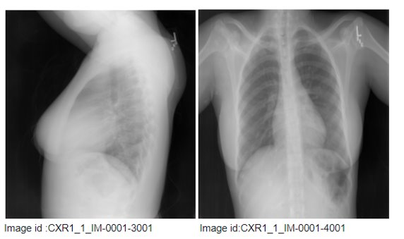
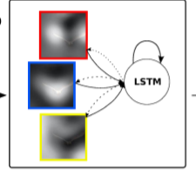
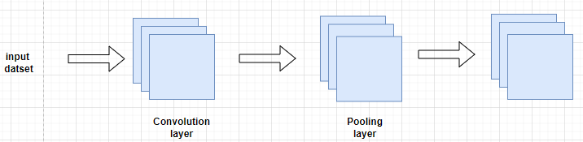
PROJECT FLOW DIAGRAM
FINAL REPORT
Input image
ENCODER
DEOCDER

Slide 9
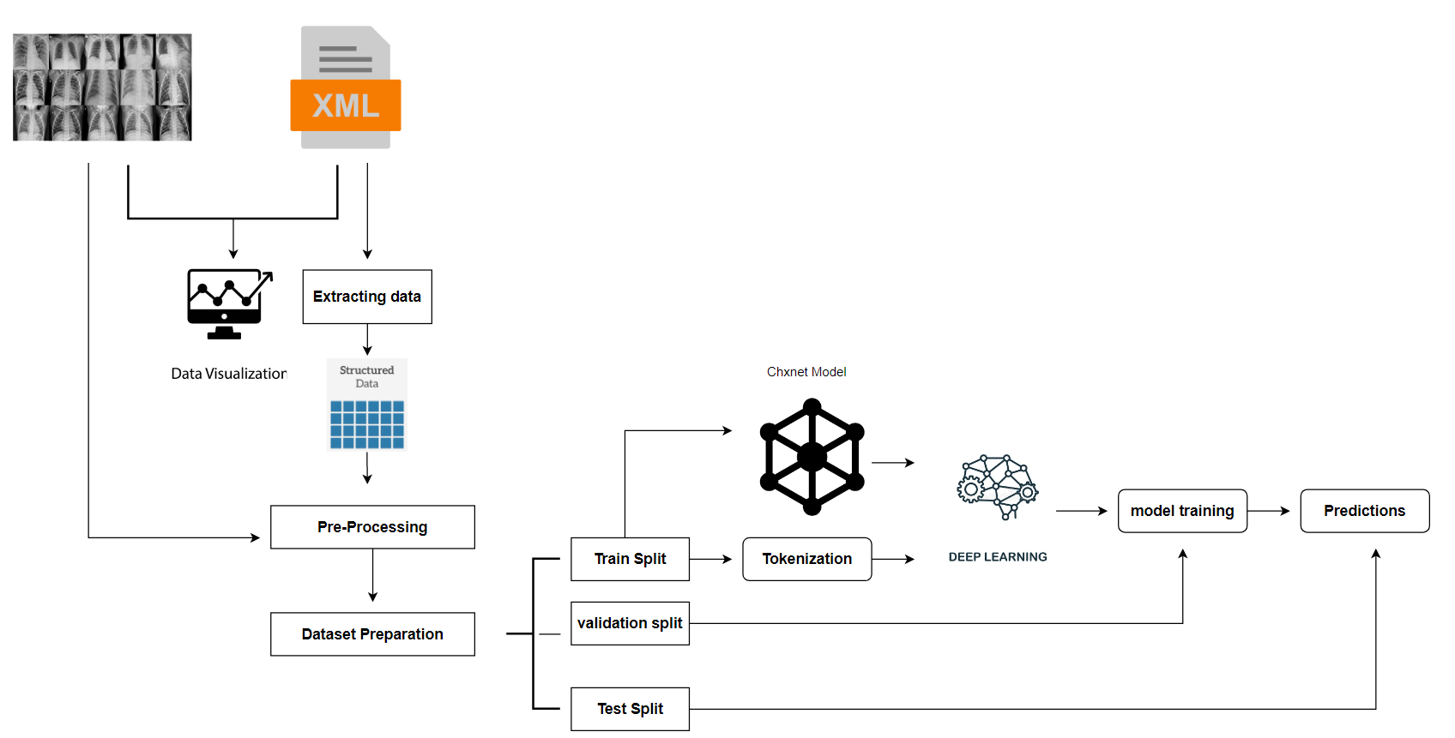
ARCHITECTURE DIAGRAM​

Slide 10
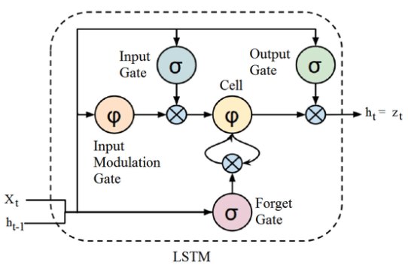
ALGORITHM-LSTM
1.Forget Gate(f) :It determines to what extent to forget the previous data.
2.Input Gate(I):It determines the extent of information be written onto the Internal Cell State.
3.Input Modulation gate(g): It is considered as a sub-part of the input gate. It is used to modulate the information that the Input gate will write onto the Internal State Cell
4.Output Gate(o):It determines what output(next Hidden State) to generate from the current Internal Cell State.

Slide 11
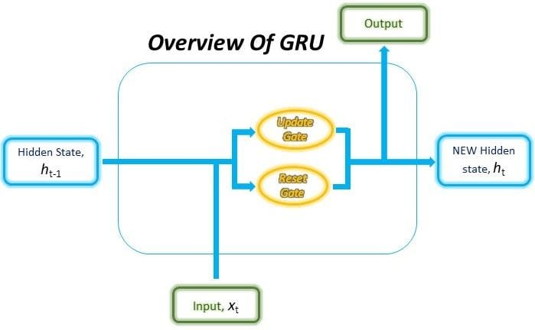
ALGORITHM-GRU
1.Update Gate(z) :It determines how much of the past knowledge needs to be passed along into the future. It is analogous to the Output Gate in an LSTM recurrent unit.
2.Reset Gate(r):It determines how much of the past knowledge to forget.
3.Current memory Gate(h(t)): it is a sub-part of the Reset gate and to reduce the effect that previous information has on the current information that is being passed into the future.
.

Slide 12
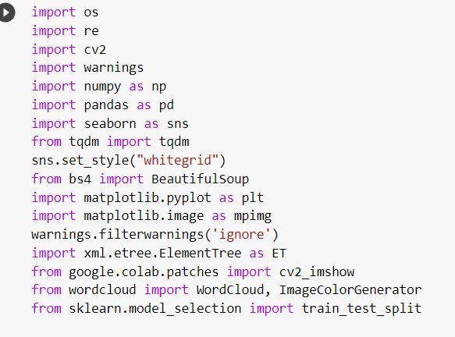
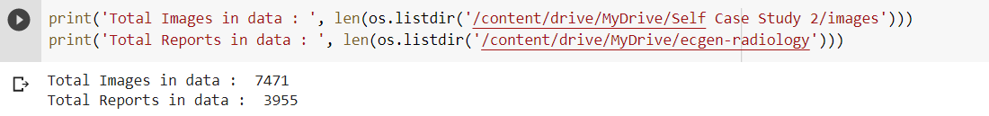
IMPLEMENTAION STEPS
IMPORTING LIBRARIES AND DATASETS (BOTH X-RAYS AND XML REPORTS)

Slide 13
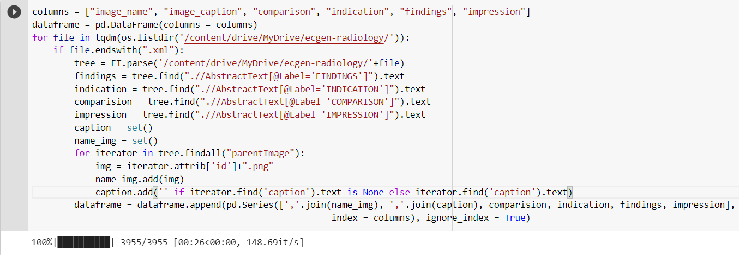
IMPLEMENTAION STEPS
EXTRACTING INFORMATION FROM XML REPORTS

Slide 14
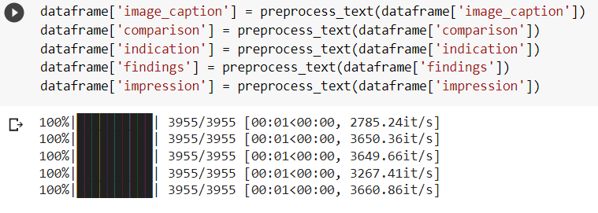
IMPLEMENTAION STEPS
DATA PRE-PROCESSING

Slide 15
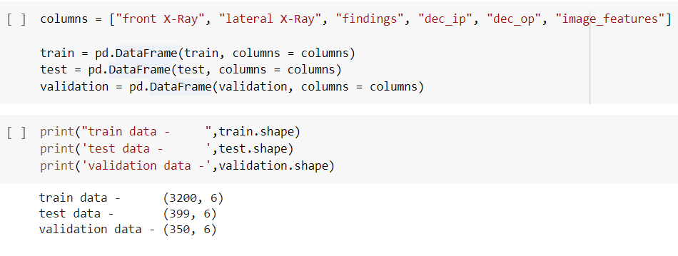
IMPLEMENTAION STEPS
SPLITTING OF DATASET

Slide 16
IMPLEMENTAION STEPS
TRAIN THE MODEL

Slide 17

IMPLEMENTAION STEPS
EVALUATING THE LOSS

Slide 18
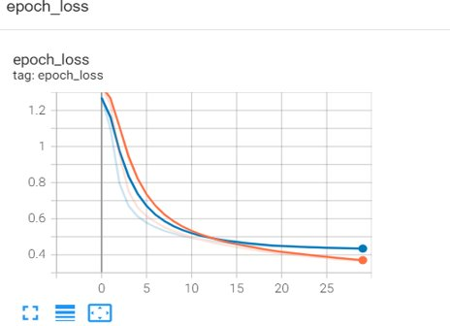
IMPLEMENTAION STEPS
EVALUATING THE LOSS

Slide 19
IMPLEMENTATION STEPS
IMPORTING LIBRARIES AND DATASETS (BOTH X-RAYS AND XML REPORTS)
VISUALIZING THE SAMPLE DATA
STRUCTURED DATA
DATA PREPROCESSING
- TEXT DECONTRACTION
- EXTRACTING THE DATA FROM XML FILES
- REMOVING THE NULL VALUES
- PREPROCESSING THE TEXT FEATURES
DISPLAYING SAMPLE IMAGES WITH TEXT FEATURES
DATASET PREPARATION

Slide 20
IMPLEMENTATION STEPS
SPLITTING THE DATASET
TOKENIZATION
LOAD CHXNET MODEL
ENCODER AND DECODER WITH ATTENTION MODEL
CUSTOM LOSS FUNCTION
MODEL TRAINING
PREDICTIONS ON SAMPLE TEST DATA

Slide 21
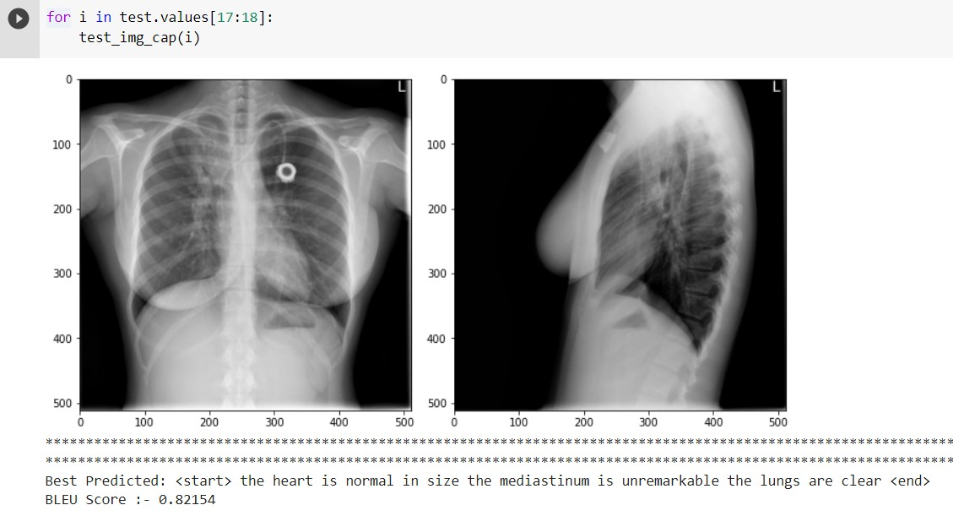
RESULT ANALYSIS
Hence generated a text report for given x-ray images with BLEU score 0.82

Slide 22
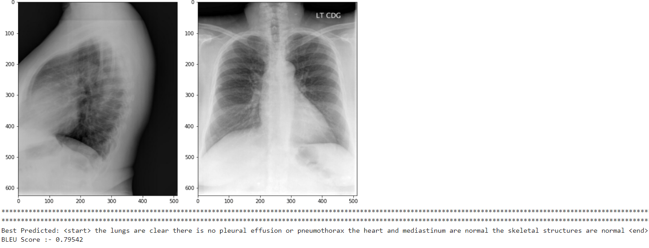
RESULT ANALYSIS
Hence generated a text report for given x-ray images with BLEU score 0.79

Slide 23
CONCLUSION
We just saw an end-to-end deep learning case study of image captioning in the medical field. We understood the problem and the need for such applications. Here we generated a report on chest x-rays and generated report by model is measured by BLEU score. By building an Attention model, The results are promising and the impression statements are meaningful according to the X-ray image.

Slide 24
Thank You

